Slide 1
SSE Digital Project Weekly Report
Week Ending 20 Nov 2020

Slide 2
Project Status Report – Digital CI Pilot
RAG Overall
Amber
N/A
Summary W/E 20th Nov | On 18th the team began the first sprint. Danielle Kelly (PO) identified and prioritised the first sprint’s activities – The Focus is Submitting a meter reading through My Account (BEC). There’s still a few elements to be resolved (below) the team are already working at great pace
This week
Last week
Sprint Goal | To develop a prototype that allows customers/TPIs to easily submit a meter reading by entering as little information as possible so that they are billed accurately
Highlights and Completed | Lowlights | Plan to return to green/Up and coming activities
Received confirmation that Danielle Kelly will be our Product Owner. Completed the initial backlog refinement and have a clear direction for the first two sprints – Meter Readings, making a non DD payment. Although everything came together last minute the first sprint planning was completed and the first Sprint backlog built Completed the first few activities/tasks within the sprint: Identifying the user types Mapping the new journey Collaboratively sketching out the pages | My Account test logins – no access to the My Account area of the BEC site. This means making assumptions on what’s in this area (based on conversations with SMEs) Team Setup – setup on tools and software conversations are still ongoing so having to run a few work arounds. Prototype Build – to ensure pace during the sprints we’ll be building the prototype in HTML/CSS rather than Vue JS. Awaiting confirmation from Steve J that we’re ok to do so. | My Account – continue to speak with the contacts we have as well as liaising with new stakeholders to obtain the logins or screenshots of the My Account Area. Raise it with Steve J Team Setup – continue to push this forward to complete the team setup within the next few working days Seek confirmation from Steve J that the team are OK to build in HTML/CSS
Key Milestone | Plan date | Actual/Est date | Notes
User Testing | 20th November | TBC | Working with Martin S to contacts TPI’s but the response time is slower than expected
Backlog Refinement | 27th November | 27th November | Work with Danielle to build out the backlog and refine the tickets for Sprint 2
Sprint Show and Tell | 30th November | 30th November | Craig and Danielle to review invitee list and circulate in advance
Notes:
Owner: Rick James

Slide 3
Project Timeline
Overall project timeline
Summary
The team are currently on track, Sprint 1 starting on the agreed date and will run for the planned 2 weeks.
The Setup phase is currently over running and there are a few actions outstanding with SSE and Sopra Steria
Notes:
Owned by: Ted Morris-Dawson

Slide 4
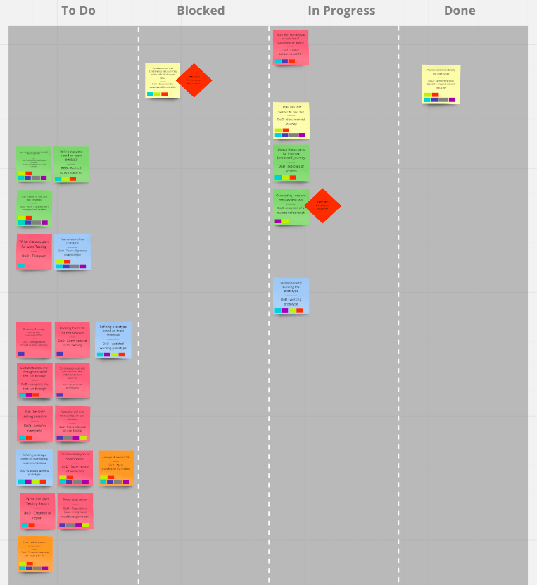
Progress Update
For sprint 1, the team are not using story points or t-shirt sizing. The team do not currently have access to Azure DevOps but will do for Sprint 2. We have time boxed the activities to ensure that we will complete the agreed activities within this sprint. The pace in which we work this sprint will be used to estimate effort in the future sprints
Future Reports will look to include a burndown report once we have access to the correct software.
Note - Attached with this report is two screenshots of the boards
Notes:
Owned by: Ted Morris-Dawson

Slide 5
Key ISSUES
REF | Description | Raised Date | Raised BY | Severity | RAG | Mitigation | Progress | Owner
I001 | N/A | N/A | N/A | L |  | N/A | N/A | N/A
Notes:
Owned by: James Harrison

Slide 6
KEY RISKS
REF | Description | Raised Date | Raised By | Severity | RAG | Mitigation | Progress | Owner
R001 | No access to the My Account Area. We are designing a solution that is based on conversation and assumptions. We’re at risking of designing a prototype that doesn’t align with the current My Account area | 13th Nov | Craig | High |  | We’re working with a number of SMEs to understand what’s in the My Account area. We’re attempting to liaise with the current website own – Angelika | Blocked – receive no response from Angelika. Fiona has asked Steve but no response either | Craig D
R004 | Prototype Build - We awaiting confirmations that the team and build the prototype in HTML/CSS over Vue JS. The team are starting to build the prototype in HTML/CSS, if we need to build in Vue JS then this will slow progress and require re-work. | 13th Nov | Craig | High |  | We’re progressing with HTML/CSS so that we have a prototype for testing rather than holding off until we have confirmation | Following up with Steve J for confirmation | Fiona P
R003 | Tools – we are still in the process of configuring the Teams account. We are also waiting for access to Azure DevOps. The team is currently running a few work arounds. Once setup we’ll need time to onboard the team to new tools and process | 13th Nov | Craig | Medium |  | The team are progressing using other collaborative tools to store files and build out the sprint backlog | Continue to work push through the setup of the tools | Craig D
Notes:
Owned by: Management Office

Slide 7
Supporting Material – as required

