Slide 1
SSE Sprint 2 User test report
Sprint 2 – Wednesday 2nd December – Tuesday 15th December

Slide 2
Contents
What we did
Objectives
Who we spoke to
Structure of the sessions
Submitting meter readings
Getting TPIs clients to submit the readings
Notes:
Owner: Rick James

Slide 3
01
What we did

Slide 4
Objectives of the research
To learn how TPIs and customers currently manage meter readings
To test the prototypes for submitting meter readings when a customer has multiple sites, each with multiple meters, to see if it improves upon the current journey
To learn if the ability to attach a photo as evidence is useful and to test the user journey for this
To get feedback on the concept of using photo recognition technology (OCR) for meter readings
To understand if getting customers to submit their meter reads directly to SSE is useful
Notes:
Owned by: Ted Morris-Dawson

Slide 5
Who we spoke to
TPIs
Works mostly with SMEs
Keen on accurate meter reads as their commission is based on usage
Submits meter reads through portal unless it’s multiple reads
Client services team
Manages clients’ accounts
Emails meter reads to SSE
Works mainly with managing agents for blocks of properties
Emails meter reads to SSE
We didn’t manage to speak to any customers during this round of testing.
Notes:
Owned by: Ted Morris-Dawson

Slide 6
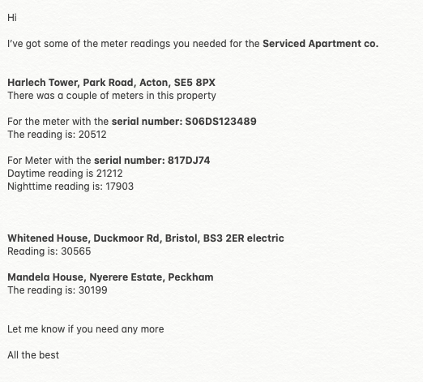
Structure of the sessions
We conducted 45 minute one-on-one video call interviews that consisted of:
An initial interview talking about their previous experience in managing energy
We sent the participants a series of meter readings for a client. The participant was tasked with entering the meter reads into the right place in the prototype, while thinking aloud
A wrap up to reflect on what they saw
Notes:
Owned by: Ted Morris-Dawson

Slide 7
02
Submitting meter readings

Slide 8
How they currently gather and submit meter readings
The TPIs we spoke to send meter readings to SSE as soon as they receive them from clients ﻿ ﻿
One TPI said they use the current SSE portal to add single meter reads to a client’s account. They prefer to do it this way as they get a quicker response than by email
All TPIs said for multiple meter readings they send them in an email to SSE
One TPI said they chase clients for meter readings to ensure that their commission is accurate, whereas another TPI said they don’t chase clients for readings
The format of the meter readings emailed to TPIs is inconsistent. One TPI who worked with managing agents for blocks of properties said the meter readings their clients collect from cleaners etc range from a scribble on a piece of paper to an Excel spreadsheet
All three TPIs said that their clients often accompany the meter readings with a photo, so the TPI can check the serial number and reading are correct and to keep as evidence in case of bill disputes
Notes:
Owned by: Ted Morris-Dawson

Slide 9
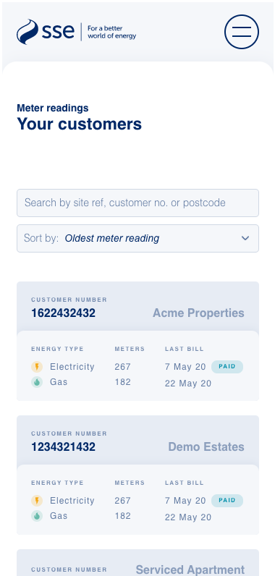
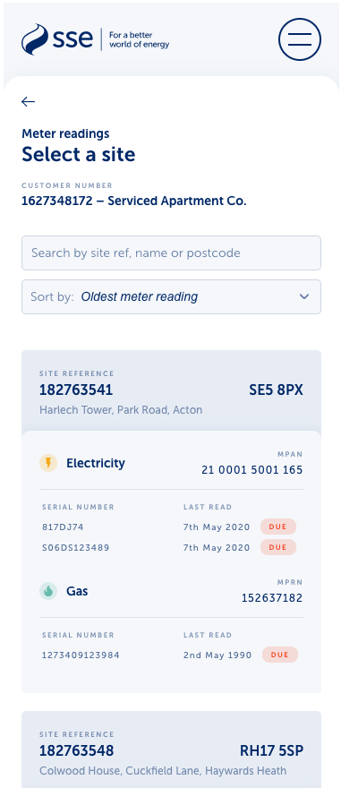
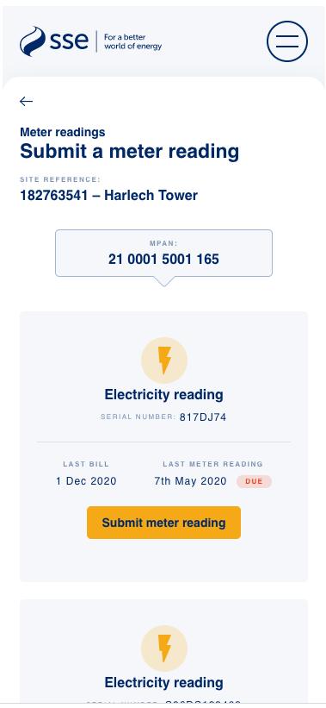
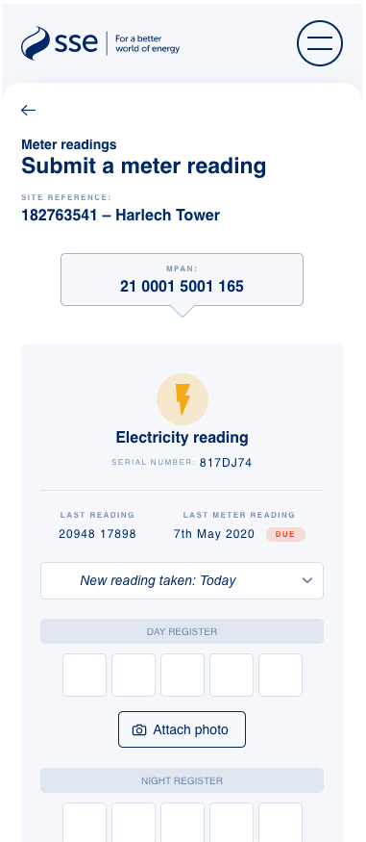
What we tested
A journey that allowed a TPI to select a customer and then a site. Some sites had multiple meters per site. The system would then show all the information about that site and the meters it contained. The TPI would only have to enter the meter reading, and had the option to attach a photo with the meter reading.
Notes:
Owned by: Ted Morris-Dawson

Slide 10
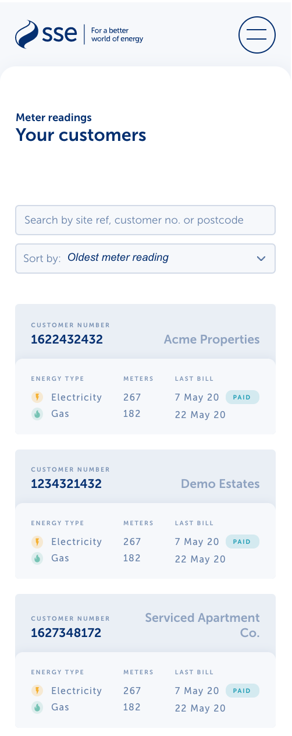
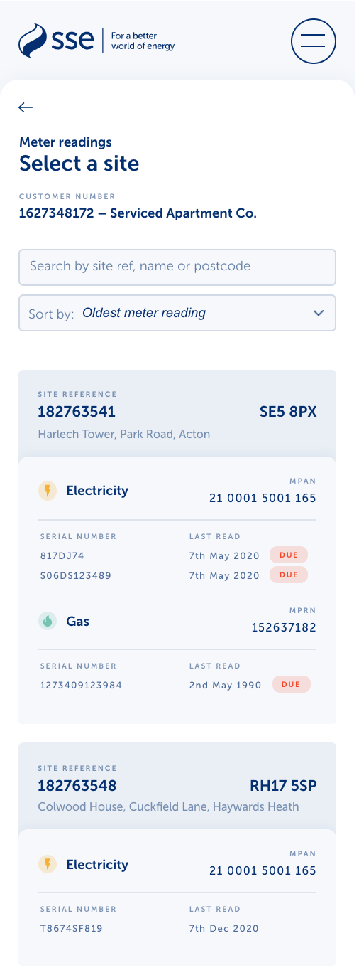
Finding a meter
In the prototype we tested, users had to search for and select a customer first, to see the sites and meters they have in their portfolio.
This didn’t match how the TPI participants expected to use it. In the testing scenario they had the serial numbers and addresses for the meters they needed to submit a reading for, so they just wanted to search for the serial number rather than find the customer first.
​ Next step: Reconsider the way sites are listed, enabling the user to get to the meter reading page in less steps.
​
​
Notes:
Owned by: Ted Morris-Dawson

Slide 11
Finding a meter
​There was some inconsistency around how TPIs identify customers and their meters. Whereas in the first sprint we heard that site reference and customer numbers were important, in this sprint two participants said they never use site reference, and one participant said they often didn’t have the customer number. MPAN / MPRN, address, customer name and serial number were consistently used to identify customers’ meters.
No participants commented about whether or not it was useful to see on this page the date the last read was taken and whether it was due.
One participant struggled with navigating back and forth as they didn’t initially notice the back button. However it’s worth noting that they were using desktop, whereas the prototype is designed for mobile.
Next steps: ​Ensure that the search functionality allows users to search for customers using all available reference numbers. Consider removing the ‘last read’ from this page to allow more space for the meter information. Make the back arrow more prominent.
Notes:
Owned by: Ted Morris-Dawson

Slide 12
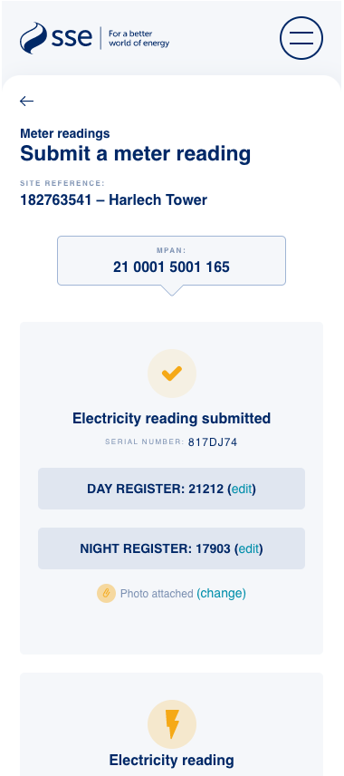
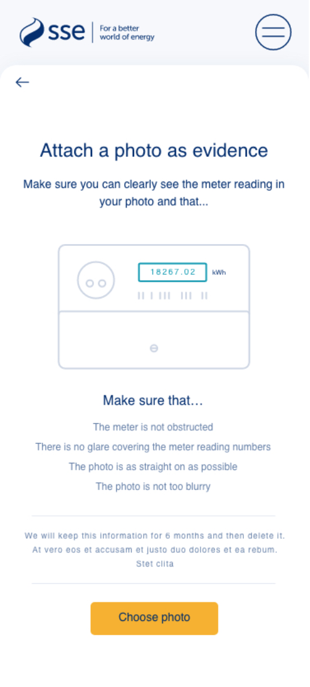
Photo uploads
The ability to upload photos was liked and participants could tell how to use it.
Participants didn't read the content explaining how to take a photo. This meant they would miss any consent messaging that we would have on this page.
There was a question and concern about upload limits as one participant had experienced problems with another supplier’s portal.
When asked how long a photo would be stored, one participant assumed the photo would be stored for the duration of the contract in case of any bill disputes.
One participant said that they would like to see a preview of the photo they had uploaded in order to confirm they had submitted the correct image but felt they were unable to do so on the prototype.
Next steps: Ensure any consent messaging is designed so the user must confirm they’ve read it. Consider incorporating a more explicit photo preview.
​
​
Notes:
Owned by: Ted Morris-Dawson

Slide 13
Photo recognition (OCR)
After investigating and designing a journey for meter reading from photographs, we don't feel it's worth pursuing.
It will create more effort for the users than it saves.
As we designed the flow for this, it became apparent that it complicated the journey. Especially if the photo overwrites a meter read the user has already entered.
TPIs may get photos that are the wrong way round or too dark so they would have to pre-edit the photos to make them work.
There’s a concern about accuracy
Smart meters are rolling out
This would also be an expensive tool to make work that may be defunct after the smart meter roll out.
Notes:
Owned by: Ted Morris-Dawson

Slide 14
Submitting meter reads
​
On the whole, participants got on well with entering a meter reading on this page.
However one participant didn’t scroll down to find the other meters listed for the site, and therefore entered the meter reading into the wrong meter. It’s worth noting, however, that they were using desktop and therefore scrolling does not feel so natural. They also didn’t use the serial number to verify the meter. This indicates that the serial number may be too small.
One participant noted that they would like the option to view historic meter reads on this page.
Next steps: Consider providing an indication of how many electricity meters and gas meters there are for each site to encourage users to scroll. Increase the serial number font size.
Notes:
Owned by: Ted Morris-Dawson

Slide 15
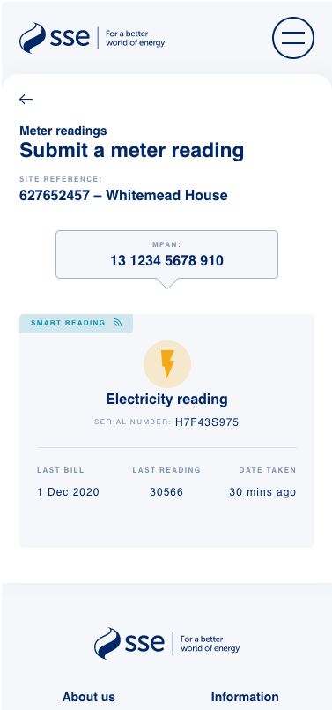
Submitting meter reads – smart meter
​
All participants understood that the smart meter readings were there for reference but could not be edited.
One participant questioned whether the system would be intuitive enough to flag if the smart meter was faulty and hadn’t taken a meter reading recently.
Next step: Discuss with the business whether it is possible for the system to detect if a smart meter hasn’t taken a reading within a given time frame.
Notes:
Owned by: Ted Morris-Dawson

Slide 16
03
Getting TPIs clients to submit the readings

Slide 17
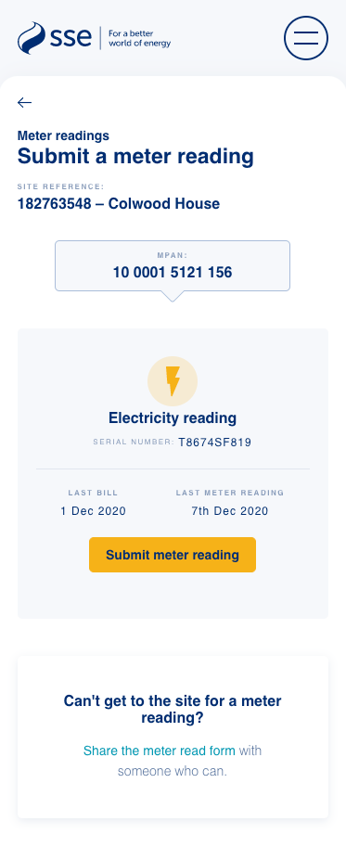
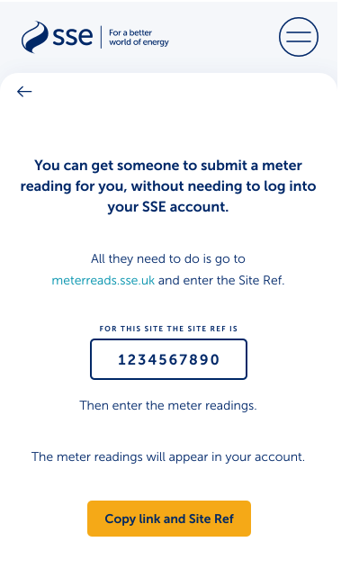
What we tested
TPIs could get a link that they could copy and paste into an email to their client, that would take the client to a micro site where they could enter the meter reading themselves.
All the client would need is the Site ID to log into the micro site. The micro site already has all the information about their site and meter. They only need to enter the meter reading.
Notes:
Owned by: Ted Morris-Dawson

Slide 18
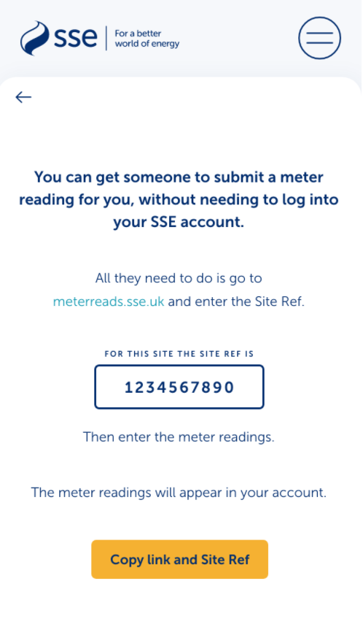
How they felt about the idea
This idea didn't go down as well this sprint.
One of the TPIs felt that the whole point of using a TPI was to do this sort of admin for the client.
There were some clients that meter read already, but they have accounts.
This idea probably isn’t worth exploring anymore. There are more vital parts of the meter read journey to get right first.
​
​
Notes:
Owned by: Ted Morris-Dawson

Slide 19
Thank You

