Slide 1


SSE
Sprint 3 User test report
Sprint 3 – Wednesday 6th January – Tuesday 19th January

Slide 2
Contents
What we did
  Objectives
  Who we spoke to
  Structure of the sessions
Making a non Direct Debit payment
Notes:
Owner: Rick James

Slide 3
01
What we did

Slide 4
Objectives of the research
To learn how customers currently manage their business energy payments
To understand if the facility for customers to make a one off payment online is useful
To understand where the one off payment link should live in the IA on https://ssebusinessenergy.co.uk/
To test the prototype for making a one off online payment
Notes:
Owned by: Ted Morris-Dawson

Slide 5
Who We Spoke To
Participant 3
Runs an events business. Has business energy for warehouse and workshop.
Pays by Direct Debit but used to pay ad hoc at Post Office.
Participant 1
Runs a hair salon.
Pays by Direct Debit and has always paid this way.
Participant 4
Landlord for two business units.
Pays ad hoc at Post Office.
Participant 2
Runs a café / gift shop.
Pays by Direct Debit and has always paid this way.
Participant 5
Book keeps and arranges payments for restaurants and properties.
Pays by Direct Debit for most, but also does some bank transfers.

Slide 6
Structure of the sessions
We conducted 45 minute one-on-one video call interviews that consisted of:
An initial interview talking about their previous experience of paying business energy bills
We sent the participants a dummy gas and electricity bill, as well as dummy card details. They were then asked to find where to make a payment on https://ssebusinessenergy.co.uk/.
The participants were then asked to pay both the electricity and gas bill in full. This required them to enter the account numbers and amounts into the right place in the prototype, and completing the payment journey in the prototype.
A wrap up to reflect on what they saw
​
​

Slide 7
02
Making a non Direct Debit payment

Slide 8
How they currently pay their business energy bills
Two of the participants paid exclusively by Direct Debit and have always paid this way. They said this method was easier because they didn’t have to think about it. It also ensured they didn’t forget to pay the bill.
One participant used to pay on an ad hoc basis because their company was in debt and they didn’t have the cashflow to pay by Direct Debit. Once they were able to they moved onto Direct Debit, which is how they currently pay. They indicated that there were significant savings to be made when paying by Direct Debit.
One participant paid at the local Post Office because they had a bad past experience of Direct Debit where he had not been able to cancel it. He also said he wanted to support his local Post Office.
One participant who was a book keeper and made payments of behalf of other businesses paid a mixture of Direct Debit and ad hoc via bank transfer. She said that her clients don't like paying by Direct Debit as they want to be able control and query payments. She, however, preferred to pay by Direct Debit because it involves less admin.
Notes:
Owned by: Ted Morris-Dawson

Slide 9
Energy is a small part of running their business
Participants talked about all the other tasks they have in their day and energy only being one they do once in a while.
A café owner described being busy from 9am to 7pm so is never free to call utility companies in office hours.
Multiple participants described having more than one energy supplier. Usually down to running their business across multiple locations.
So what?...
This highlights the need for the online payment system allowing people to pay at a time that is convenient.
It’s also important to remember that this task will be done infrequently and in the middle of other tasks, so users may be in a rush, distracted and may not use it often enough to remember how it works.

Slide 10
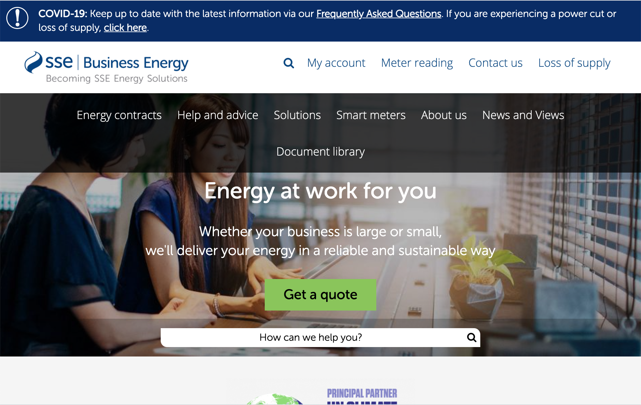

Finding the payment form
Participants assumed they would have to create an account to pay so went to the My account page to find where to pay.
Those who couldn’t find it used the search function.
However the search was confusing. When you click in the search box it says ‘How can we help you’. This looks like a link rather than a search box. Participants ended up clicking search again, which returned a set of generic search results.
​
​

Slide 11
What we tested
A journey that required a customer to enter their gas and electricity account numbers and bill amounts into the prototype, followed by credit / debit card details and email address.
Notes:
Owned by: Ted Morris-Dawson

Slide 12
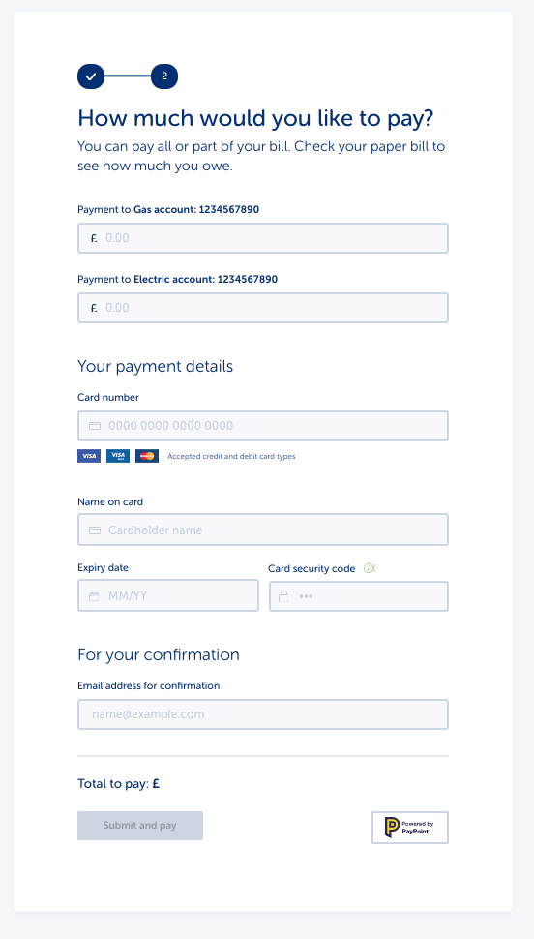
Form usability
Overall the usability of the form performed well. All participants completed the payment successfully.
Participants were able to enter the credit card details correctly.
Participants were happy to provide an email address and even expected to need one for a receipt.
Nobody described the process as difficult or hard to use.
There were however some improvements that can be made…
​
​

Slide 13
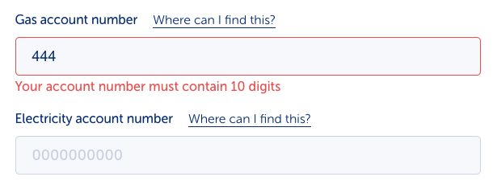
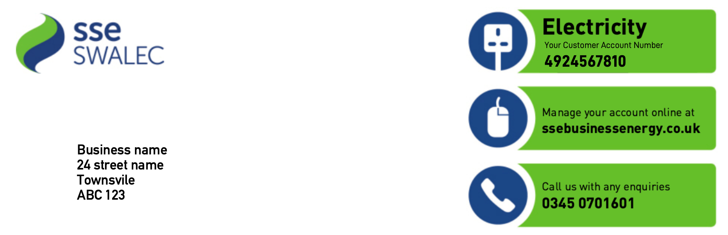
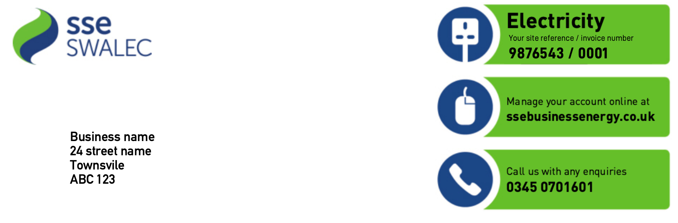
Finding the account number
None of the participants got the account number right first time. They all struggled to find it on the bill.
Some missed the link to show the instructions on where to find the account number. This left them trying to find it on the bill on their own, which took some time.
One participant inputted the site reference number as it looks very similar to the account number on the paper bill.
However, all the participants noticed their mistakes thanks to the validation based on number of digits and corrected their mistake.
Next steps:
Make the instructions on where to find the account number clearer on the form.
Consider reviewing the design of the paper bill. Make the account numbers and site references more distinct.
Paper bill page 1
Paper bill page 2

Slide 14
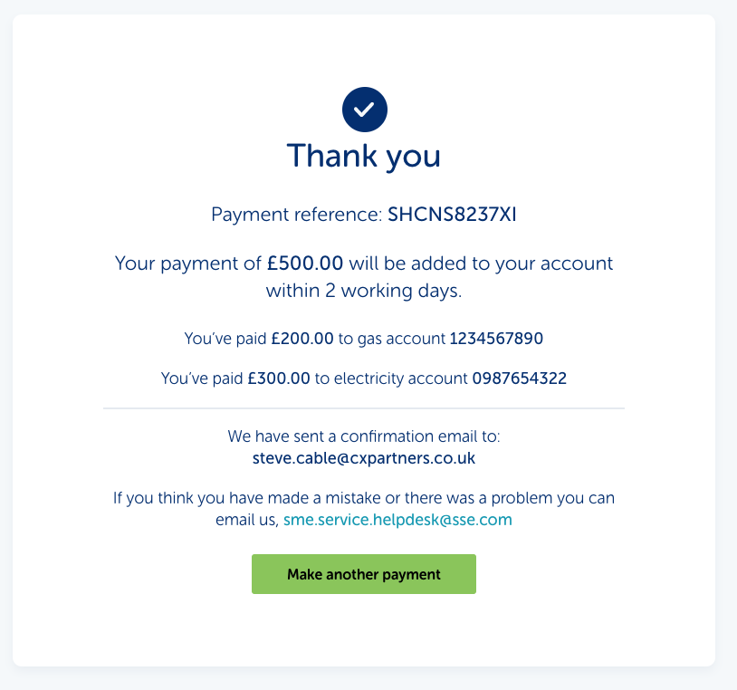
Confirmation
The confirmation page made it clear what had been done and participants felt confident the payment had gone through.
Participants all talked about wanting to send the receipt onto their accountant.
They wanted a Date as that was important for keeping record of the payment.
The account numbers weren’t spotted by one participant. This means they didn’t check if the number was correct.
Next steps
Add a date to the confirmation.
Make the account numbers more prominent.
​
​

Slide 15
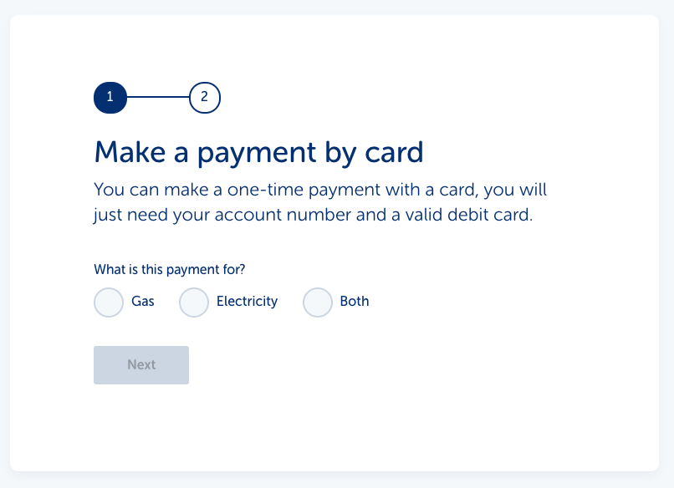
Setting expectations
When asked how confident participants were that the payment had gone to the right place, they were very confident.
They all assumed by typing in their account numbers the system had brought up their account details.
This meant the participants weren't that careful in checking they’d typed the right account number.
When we explained how the form worked and it was on them to get the account number right they had not realised this was the case.
One participant stated they would have been more careful if they’d have known.
Next step:
Make it clear up front how the form works so people are more careful. We could also use this to let people know what they will need to complete a payment (Their account number, a bill and a visa, or master card).
​
​

Slide 16
Thank You

