Slide 1
SSE Sprint 1 User test report
Sprint 1 – Wednesday 18th November – Tuesday 1st December

Slide 2
Contents
What we did
Objectives
Who we spoke to
Structure of the sessions
Meter readings
Getting TPIs clients to submit the readings
Notes:
Owner: Rick James

Slide 3
01
What we did

Slide 4
Objectives of the research
To learn how TPIs and customers currently manage meter readings
Test the prototypes for submitting meter readings to see if it improves upon the current journey
Understand if there is a way we can get end customers to submit their meter reads directly to SSE. Preventing the need for large spreadsheets to be shared by TPIs
Notes:
Owned by: Ted Morris-Dawson

Slide 5
Who we spoke to
TPIs
Customers
Has around 1000 clients with SSE
(12% of their portfolio)
Works primarily with schools
Local authority energy manager
Has to manage the energy of a range of building types, from stairwells in blocks of flats to public toilets and temporary accommodation
Block management
Manages around 1000 sites.
A high amount of meter with low uses. E.g. Shared areas in blocks of flats
Property manager
Has around 1500 properties.
Mix of commercial and domestic
Notes:
Owned by: Ted Morris-Dawson

Slide 6
Structure of the sessions
We conducted 45 minute one-on-one video call interviews that consisted of:
An initial interview talking about their previous experience in managing energy
Completing tasks using the prototype, while thinking aloud. Describing what they are seeing, thinking and doing.
A wrap up to reflect on what they saw
Notes:
Owned by: Ted Morris-Dawson

Slide 7
02
Submitting meter readings

Slide 8
How they currently gather and submit meter readings
TPIs get drip fed meter reads and puts them in a spreadsheet. Forwards them to SSE to add into the system.
One customer talked about having hundreds of photos of meter reads on their phone. They would often just send photos to a contact at SSE to input the reads for them.
The local authority customer did enter their meter reads using the portal. However they did not like the effort required as they had to enter all the details about a meter and the site every time.
There was also concerns about whether the online form actually submitted readings or if it still had to be entered into the system by someone at SSE.
Notes:
Owned by: Ted Morris-Dawson

Slide 9
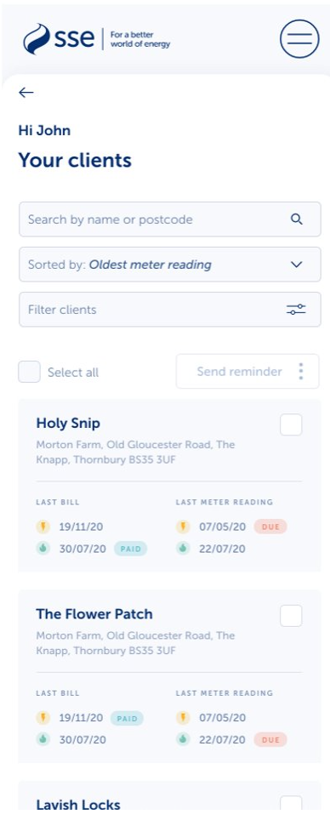
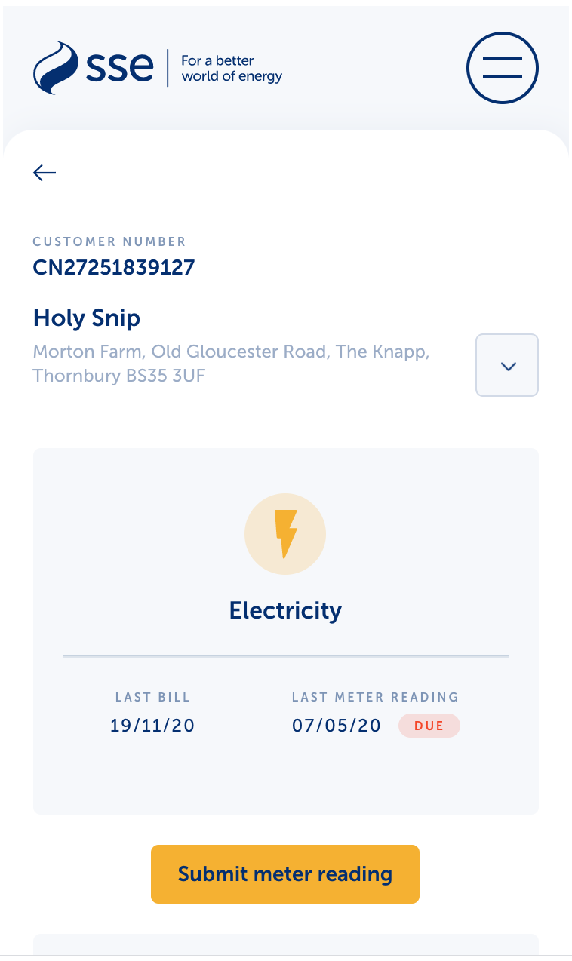
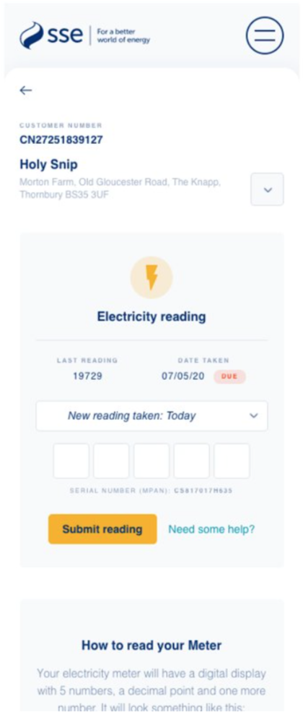
What we tested
A journey that allowed a TPI to select a customer and a site. The system would then show all the information about that meter and site. The TPI would only have to enter the meter reading.
NOTE: We only focused on a very simple single site, single meter example.
Notes:
Owned by: Ted Morris-Dawson

Slide 10
Findability & identification
We made an assumption that structuring the list of clients, or sites in a human way – using business name or address - would make them more recognisable. ​ ​ However for larger customers and TPIs this assumption was wrong. They use customer numbers or site numbers instead. This is because addresses may be entered in the system incorrectly. It may also be because of the large number of sites or customers they have in their account. ​ ​ Next step: Reconsider the way clients are listed, focussing on customer numbers and site numbers to identify meter locations. ​
​
​
Notes:
Owned by: Ted Morris-Dawson

Slide 11
Findability & identification
​Serial numbers are an important part of the meter reading screen for larger customers and TPIs. One site may have multiple meters.
For Oxford City Council the physical location of a meter may make it unclear which address it belongs to. Instead they need to confirm it's the right meter via serial number.​
Next step: We need to make the serial numbers more prominent on the meter readings page
​
Notes:
Owned by: Ted Morris-Dawson

Slide 12
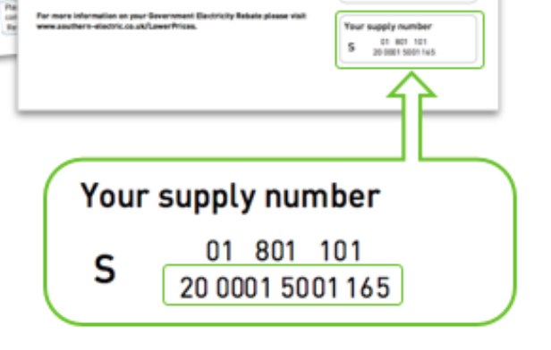
Naming conventions and a lot of numbers
There is an inconsistency in the naming of MPAN numbers.
On the SSE site and the portal it is referred as MPAN. On printed bills it is called supply number.
This has the potential to cause confusion.
Service account numbers are also called site IDs.
Customers may also not be aware of what all the numbers in the portal are or mean. The participant from the local authority described having hundreds of customer numbers, which shouldn’t be the case. They were perhaps referring to Service account numbers.
Recommendation: Given the volume of different numbers associated with a meter and a customer, there needs to be consistency in how certain numbers are referred to. Especially when communicating with customers.
On the SSE site
On the SSE bill
Notes:
Owned by: Ted Morris-Dawson

Slide 13
Submitting meter reads
​The participant from a local authority voiced their frustration at having to repeatedly fill in the ‘submit reading’ form on the current portal.
Having the meter read functionality within the portal would help with this. They were happy with only having to enter the meter read number and the date.
They did wonder how this would work with multiple meters on the same site. ​
​
Participants were not sure if the last meter read was an estimate.
Being able to add the date taken was important as the people entering the readings aren’t always the people at the property. They will be sent the numbers and may enter them a few days later. ​
Next steps: Flag if a reading was an estimate, work on version with more complex meter set ups.
​
Notes:
Owned by: Ted Morris-Dawson

Slide 14
Submitting meter reads
Participants were concerned about accuracy of the readings and human error. There needs to be some form of validation in place to flag if a reading entered looks inaccurate, to help reduce human error. E.g. lower than previous read or vastly higher.
Next steps: Consider validation of the meter reading form fields.
Notes:
Owned by: Ted Morris-Dawson

Slide 15
Photos
Both TPIs talked about taking photos and sending them to SSE as evidence.
One customer talked about having hundreds of photos of meter on their phone from all their properties.
Some even just sent photos to SSE to read and input into the system.​
​
Next steps: We want to investigate the reliability and value of adding meter readings by users uploading a photo of their meter reading, and whether users will trust this process.
Notes:
Owned by: Ted Morris-Dawson

Slide 16
Photos
Advantages include:​
as well as the image of the meter reading, photographs contain timestamps​
reducing input time​
reducing keying errors​
reducing bill disputes​
​
How can we do this?​
Optical Character Recognition (OCR) converts texts in image documents into machine-readable digital data format.​
APIs and open-source solutions​
​
Potential pitfalls:​
meters have several pieces of text on them - can the OCR detect the correct numbers?​
can images produce accurate results with poor levels of contrast/low quality?​
does the cost of this technology outweigh the benefits?
=
“01326”
Notes:
Owned by: Ted Morris-Dawson

Slide 17
03
Getting TPIs clients to submit the readings

Slide 18
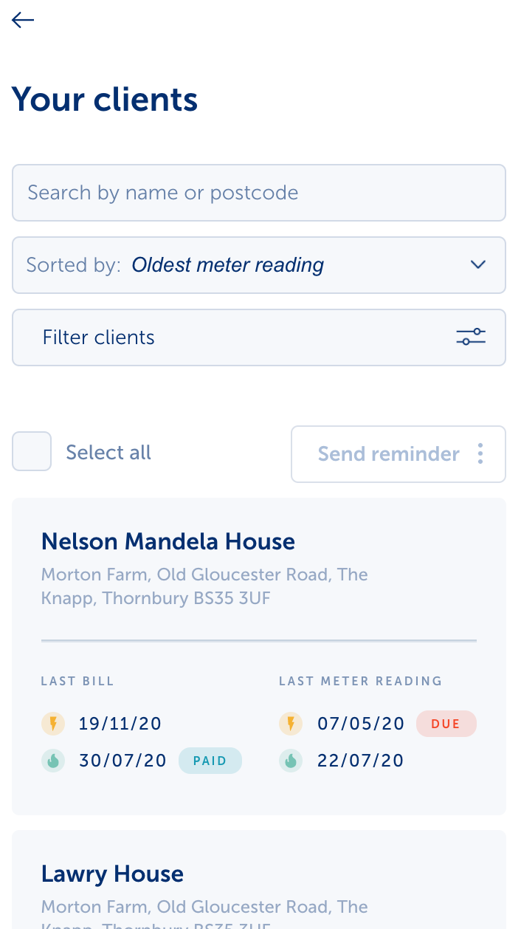
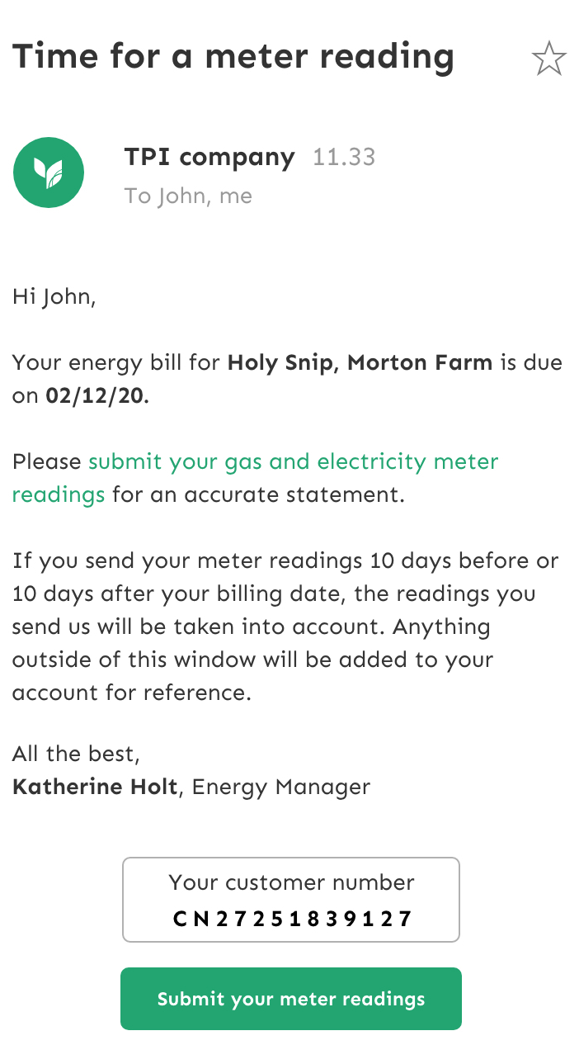
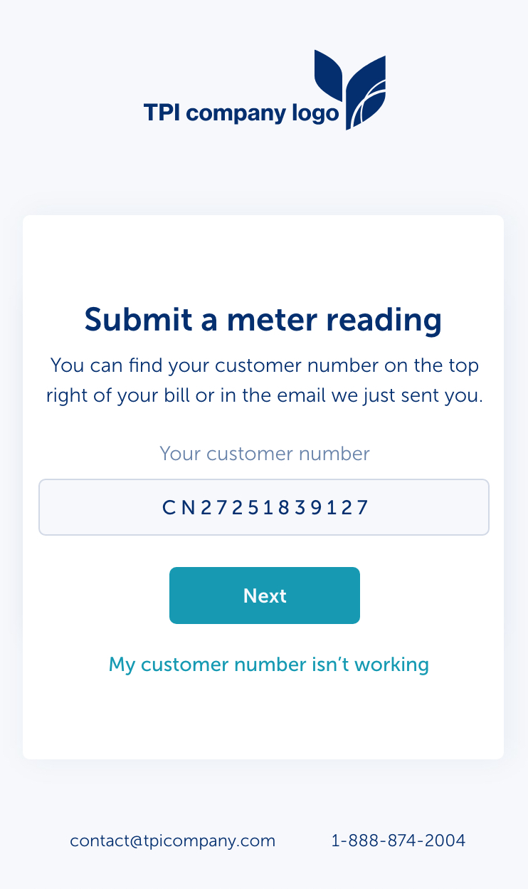
What we tested
TPIs could send reminders to client within the portal.
The Client receives an email with a link to a micro site.
They can log into the site with minimal information e.g. customer number.
The micro site only allows them to submit a meter read, but it already has all the information about their site and meter. They only need to enter the meter reading.
Notes:
Owned by: Ted Morris-Dawson

Slide 19
How they felt about the idea
Participants talked about producing their own app to gather clients meter reads. So there is a potential need for this.
TPIs wanted to the maintain their relationship with the client and were worried that if the client interacted directly with SSE, they could lose their business. The idea of the TPI being able to brand the meter reading micro site was liked for this reason.
TPIs don’t store client contact details in the portal, so sending reminders from the portal will not work without a lot of admin effort from the TPI.
Notes:
Owned by: Ted Morris-Dawson

Slide 20
Submitting a meter reading without an online account
Submitting readings needs to be as easy as sending an email, as that is how clients currently do it.
With that in mind, we wanted to avoid the client having to enter a lot of information about their site and the meter. So how can we retrieve data on a meter without logging into an account?
We considered postcode, but this may not be secure enough as you could enter anyone's postcode and submit a false reading.
We settled on customer number as this would be harder for people outside your organisation to guess.
However customer number may not be the best unique ID as a customer could have hundreds of sites under the same customer number. ​
Next steps: Re-think how we can identify people and link them up to their meter details. This would possibly be service account number.
Notes:
Owned by: Ted Morris-Dawson

Slide 21
Thank You

