Slide 1
SSE Sprint 3 User test report
Sprint 3 – Wednesday 6th January – Tuesday 19th January

Slide 2
Contents
What we did
Objectives
Who we spoke to
Structure of the sessions
Making a non Direct Debit payment
Notes:
Owner: Rick James

Slide 3
01
What we did
Sprint 1 user testing report

Slide 4
Objectives of the research
To learn how digital signatures will fit into the new contract sign up process
Specific questions were:
How would people feel about being emailed a contract to use digital signatures while on the phone?
Are there any usability issues with Digital signatures?
Are the contracts readable in digital signature apps?
Can we encourage people to create an account?
What different scenarios would we need to support? e.g. number of signees
What are people's expectations on storing contracts, LOAs and Direct debit agreements?
Notes:
Owned by: Ted Morris-Dawson

Slide 5
Who We Spoke To
Participant 1
Owns a wind turbine
Has both supply and feed in contracts.
Finds deals and signs all the contracts themselves.
Participant 3
Works for a local Authority managing the energy for a variety of buildings.
Helps find the deals then passes the contracts onto a number of different people to sign.
Participant 2
Book keeps and arranges payments for restaurants and properties.
Finds and signs contracts on behalf of their clients.
Participant 4
Manages energy contracts for a factoring business. Manages hundreds of properties.
Finds deals and preps the contracts for her boss to sign.

Slide 6
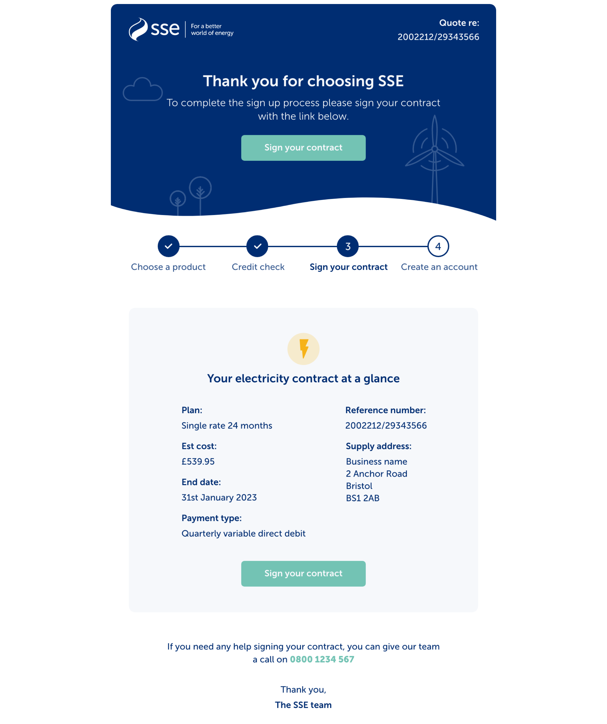
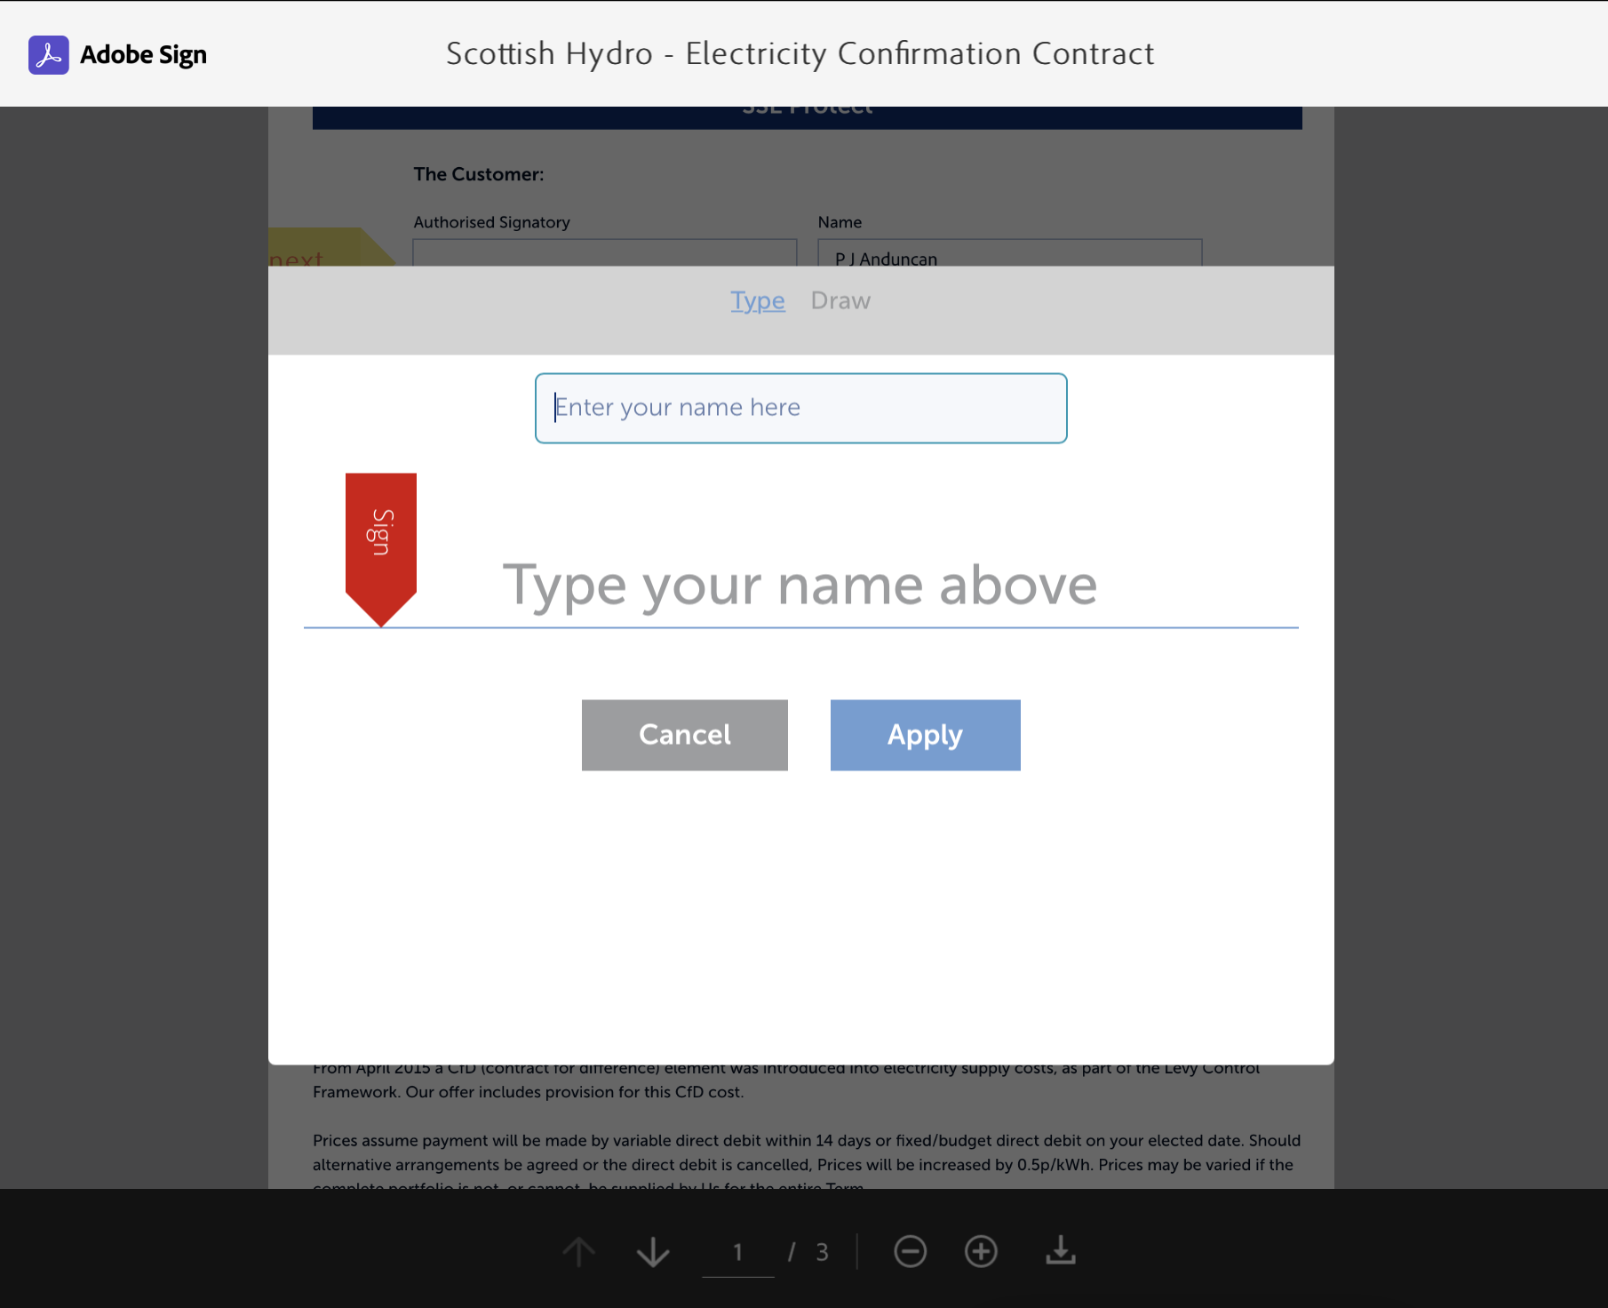
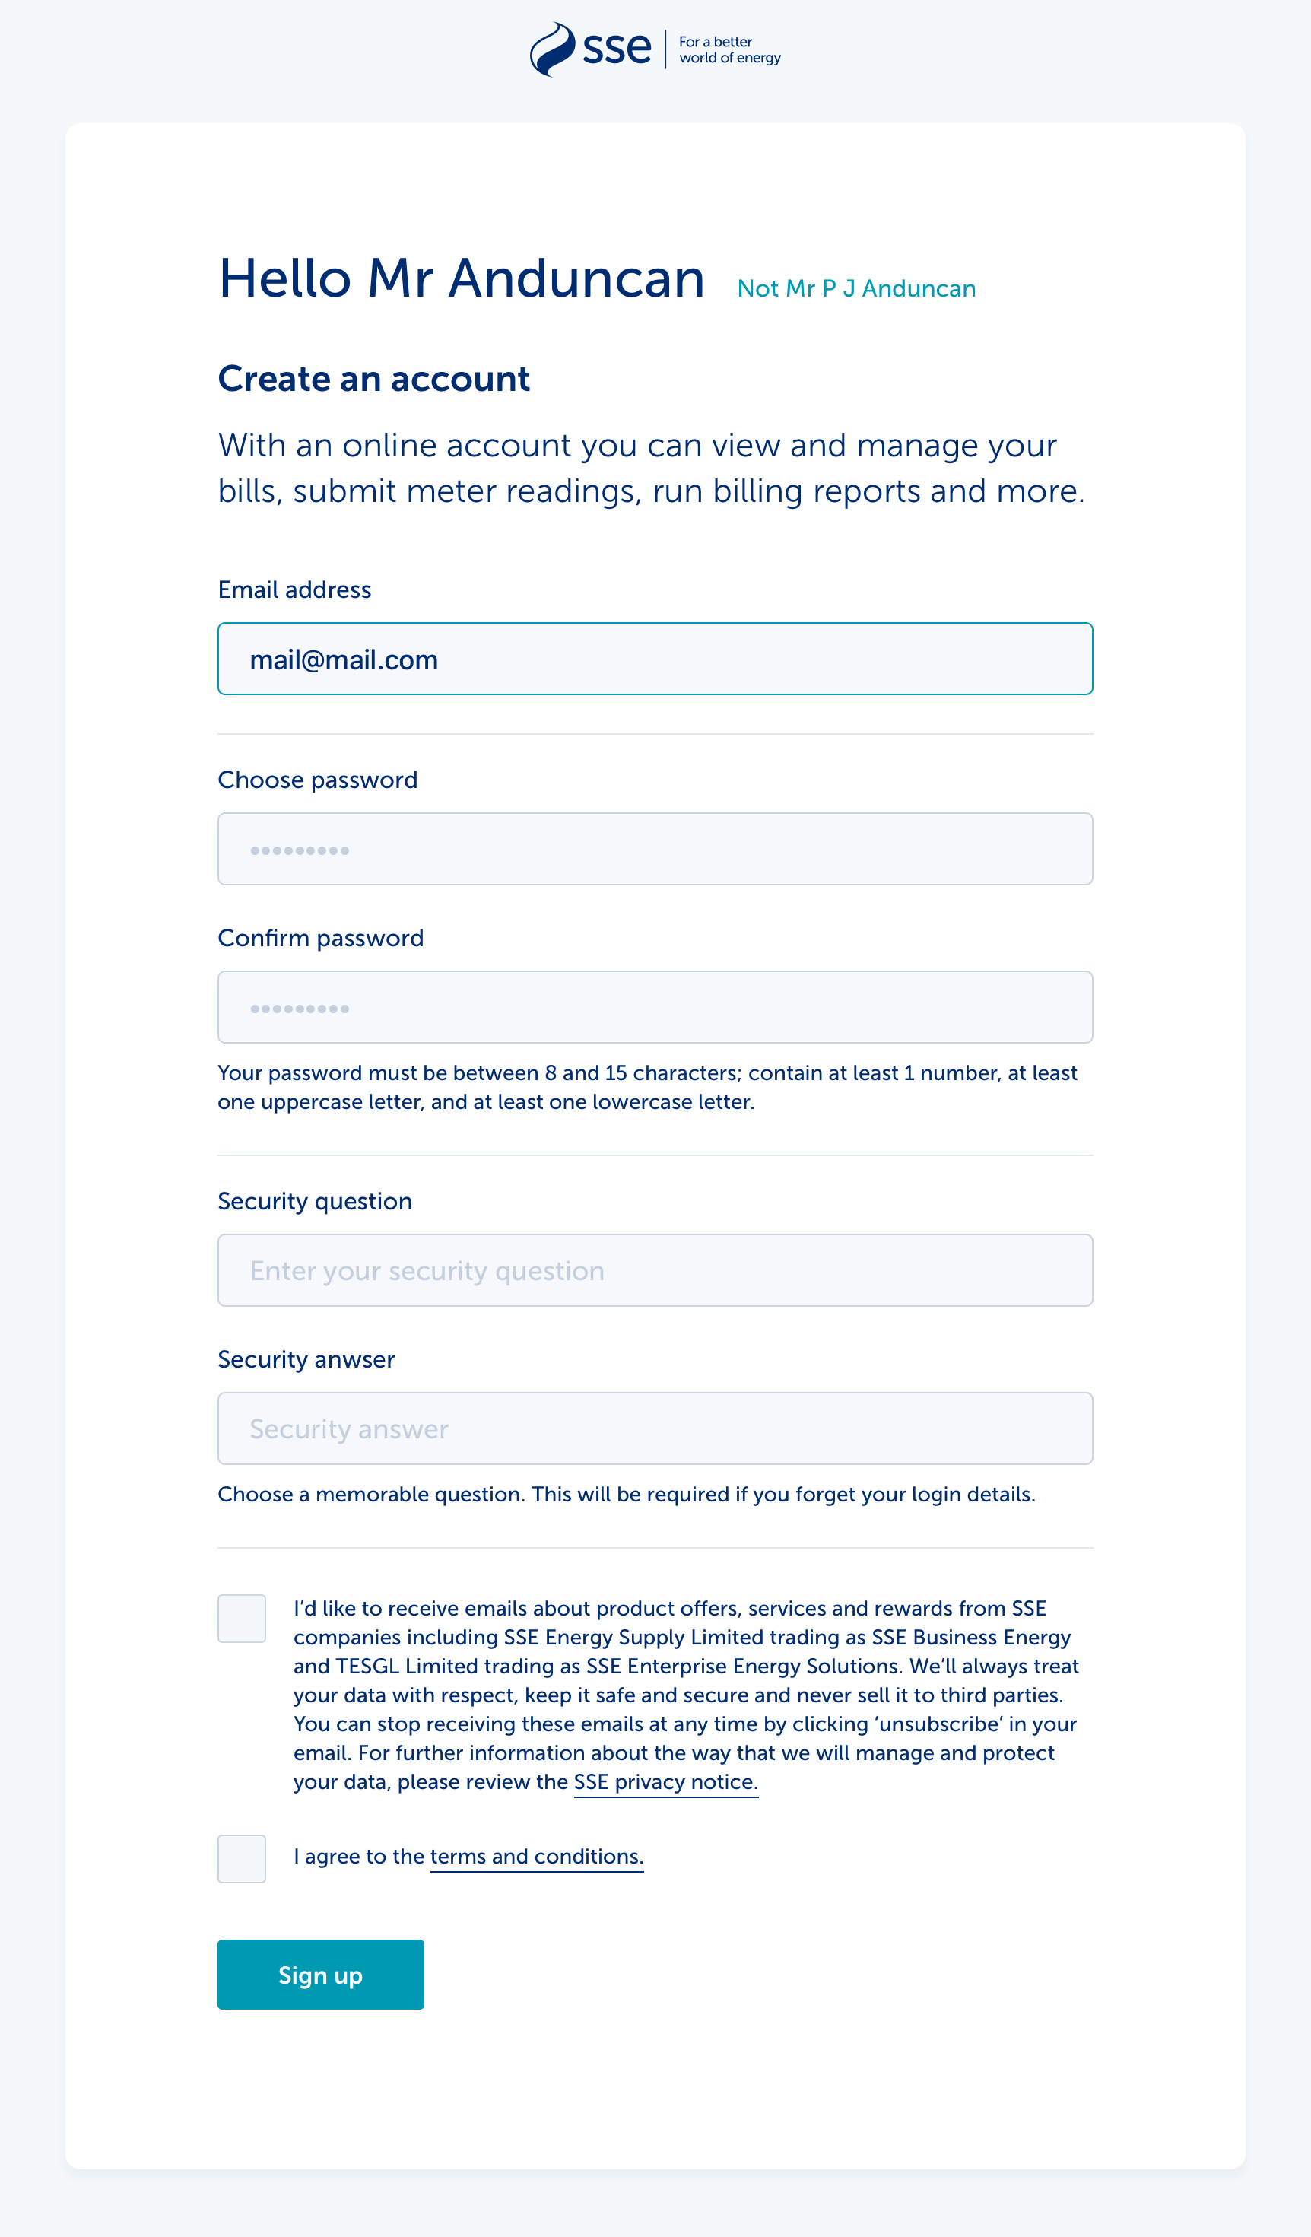
Structure of the sessions
We conducted 45 minute one-on-one video call interviews that consisted of:
An initial interview talking about their previous experience of searching for and signing up to energy deals
We then took them through a prototype of receiving a energy contract via email, signing a digital contract and creating an online account.
​
​

Slide 7
02
What we found out
Sprint 1 user testing report

Slide 8
Email
Being passed from the phone to email was fine for participants. But one mentioned wanting to stay on the line until they received it to make sure it came through.
There was no mention of the participants name which made them question if they could trust it.
MPAN number/supply address is useful for clients with multiple sites.
Not clear from the email how long they have to sign it.
Recommendation:
Add the recipients name to the body of the email to build trust
Include the MPAN number
Be clear what date the contract needs to be signed by,

Slide 9
Contract
The re-designed contract was scannable, but there were still some issues to fix.
Participants who wanted to review all the details were surprised that there was more terms and conditions under the place where they had to sign. They expected all the details to come before you are asked to sign.
It’s not clear what the supply address is on the contract. They assumed it was the address under the MPAN number but it wasn’t explicit.
There were unnecessary questions for participants.
Fax number was no longer relevant.
Company Reg number wasn’t relevant for the participant from a local authority
Participants assumed they had to complete all the form fields on the contract, not just the one with the tab on it.
Recommendation
Redesign the form so only the necessary form fields are on it. Don’t use the contract as a way to gather contact details, this should be done elsewhere in the journey.
Give the supply address a ‘Supply address:” label

Slide 10
Who’s signing?
Pre-filling the form won’t work all the time
The contract design included pre-filling some of the customers information that they would have previously given as part of the sales process.
The idea with this was to save time. However, this didn’t work for some participants.
Participants had different scenarios around who would sign.
Some were responsible for signing themselves. One described having to pass on the contract to be signed by someone else. That someone depended on who was available that day.
Another described prepping contracts to be signed by their boss. They would fit out all the details except the signature, then just hand it over for their boss to sign. Does Adobe Sign
Recommendation:
Don’t pre-fill the form.
During the sales call, the customer should be asked who the contract should be sent to.
Investigate if adobe sign supports collaborating on one contract.

Slide 11
Trust
People don’t know the difference between digital signatures and e-signatures
Participants claimed to have used digital signatures in the past were surprised by how Adobe sign worked.
They were used to adding pictures of signatures to PDFs (this is an e-signature)
When they saw all they needed to do was type a name, they questioned how secure this was.
How would SSE know the person who was supposed to sign it had actually signed it?
Recommendation:
We will need to set customers expectations as part of the sales process. Perhaps while on the phone to sales staff they could check if they’ve done digital signatures in the past and explain a bit about how they work.

Slide 12
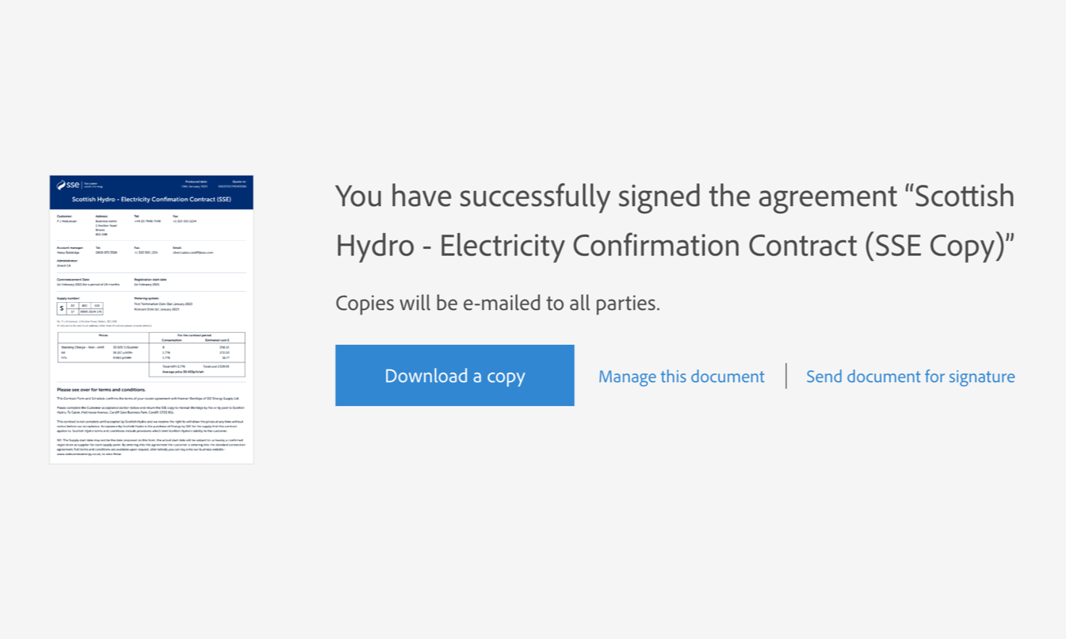
Confirmation
Theres not a lot of detail in the confirmation
There is no mention of what SSE is going to do next or what the customer needs to do.
Send document for signature option felt too late
For participants who needed to send the contract on to someone else, they needed the option to forward it on before they signed it.
Upsell to create an account
The process we designed relied on the customer checking their email as the point of upselling the account creation. However some participants didn’t feel the need to check their email as they could download a copy of the signed contract from here.
​
Recommendation:
If the Adobe sign confirmation screen can be customised, make it clearer what the customer needs to do next. For new customers have a link to set up their online account. ​

Slide 13
Confirmation email
The confirmation email was designed to do 2 things. Confirm the signature was complete and encourage customers to create an account.
Participants didn’t ay much attention to the body of the email and would have just continued to create an account.
They all had online accounts with their current suppliers so understood the benefit of it.
When asked what features they expected from an online account:
Checking bills
Meter reads
Being reminded when it’s time to renew
Storing contracts in their online account was seen as useful
Especially when customers need to check what they are being billed against their agreements. This way everything is in the same place.
​
​

Slide 14
Sign up
Expectations around signing up
Participants expected a simple sign up flow, but this form was simpler than they were expecting. Some participants expected to add MPAN numbers.
Security questions
Participants described struggling to come up with security questions. They also described forms with a drop down of security questions, but having trouble knowing how to answer them. For example, they couldn’t remember the name of their first pet.
Participants described preferring using other methods of authentication like text massages.
Recommendation:
Consider moving away from using security questions.
​
​

Slide 15
03
Summary
Development Approach Overview

Slide 16
Summary
The person receiving the contract is often not the person signing it, who they get to sign may depend on who is available that day
Some people need to prep the contract so all the person signing needs to do is sign.
This means pre-filling details in the contract may often cause problems
The initial email
It was clear from the email what participants had to do
There was some trust issues with the email. It was missing their name and some key information
The contract
The contract was readable, but there were some usability issues.
People tried to click on form fields that they didn’t need to fill out
It was unclear where the supply address was
Sign up form
The sign up form was clear and simple, but people find security questions difficult to come up with

Slide 17
Recommendations
Ensure Adobe sign supports various contract signing behaviours. Passing on for signature. Prepping contracts for signature
Help build trust in digital signatures for people who haven’t used them, by setting expectations on how it will work.
The initial email
Include the customers name, MPAN number and agreed rate in the email to help them trust it’s from a legitimate source
The contract
Don’t pre-fill details in the contract as the customer may not know who’s signing it until the last minute
Remove any optional fields from the contract
Clearly label the supply address
Sign up form
Use different authentication method other than security questions

Slide 18
Thank You

