Slide 1


SSE
Digital Project Show and Tell
Sprint 3 – Wednesday 6th January – Tuesday 19th January

Slide 2
Show and Tell Agenda
Meeting Introductions – Craig
Sprint Overview – Danielle
Design Approach Overview – James
Development Approach Overview – Dave
Prototype Demonstration – Steve/Anna
What We’ve Learnt – Steve/Anna
Backlog Priorities – Danielle
Next Steps - Craig
Notes:
Agenda walkthrough
Hand over to Danielle

Slide 3
01
Sprint Overview

Slide 4
Sprint Overview
Sprint 3 Overview – Non Direct Debit Payments
User Goal(s) - Enable customers to make online payments from multiple devices. Allowing customers to pay bills any time and anywhere with confidence﻿
Business Goal(s) - Reduce business debt. Allow for a new payment type – online payments. Reducing call centre numbers﻿
Sprint Goal - To develop a prototype that enables customer to make online payment from multiple devices. A prototype that allows customers to pay bills any time and anywhere with confidence﻿.
Deliverables
Working prototype (built in Vue JS)
Assets for prototype
Testing Report (based on user testing)
Core Scrum Team
Danielle Kelly – Product Owner
Craig Derrick – Scrum Master
Steve Cable – Service Design Lead
Anna Boscoe – UX Consultant
Dave Martin – Creative Technologist
James Shih-Gillen – UI Designer

Slide 5
02
Design Approach Overview

Slide 6
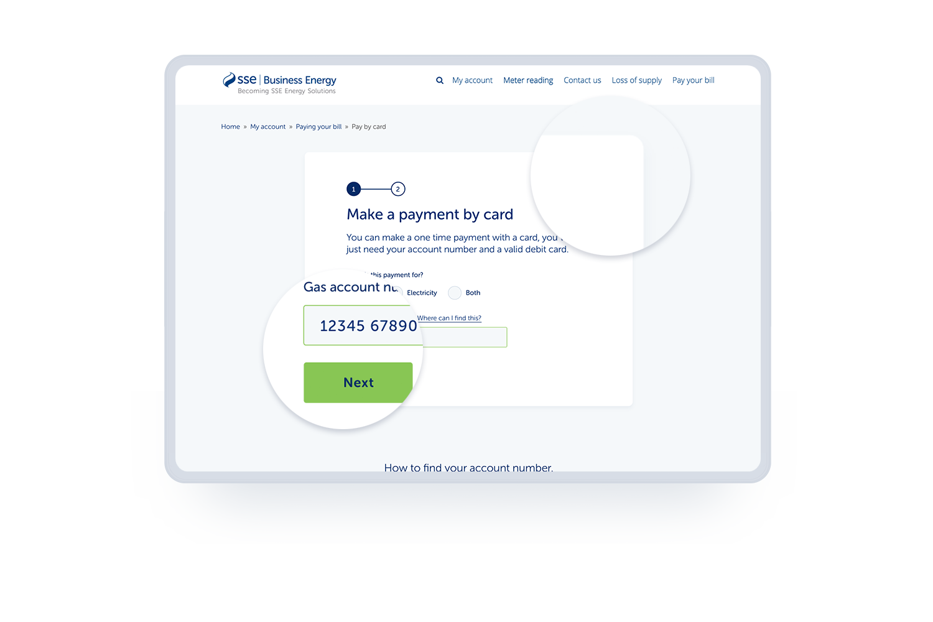
Design Approach Overview
Sketching - Sketching as a team
XD Designs - Creating high fidelity designs
CSS - Supporting Dave in building the prototype
Look and feel
Enhancement to current styles
Clean, clear and unobtrusive
Rounded corners and shadows

Slide 7
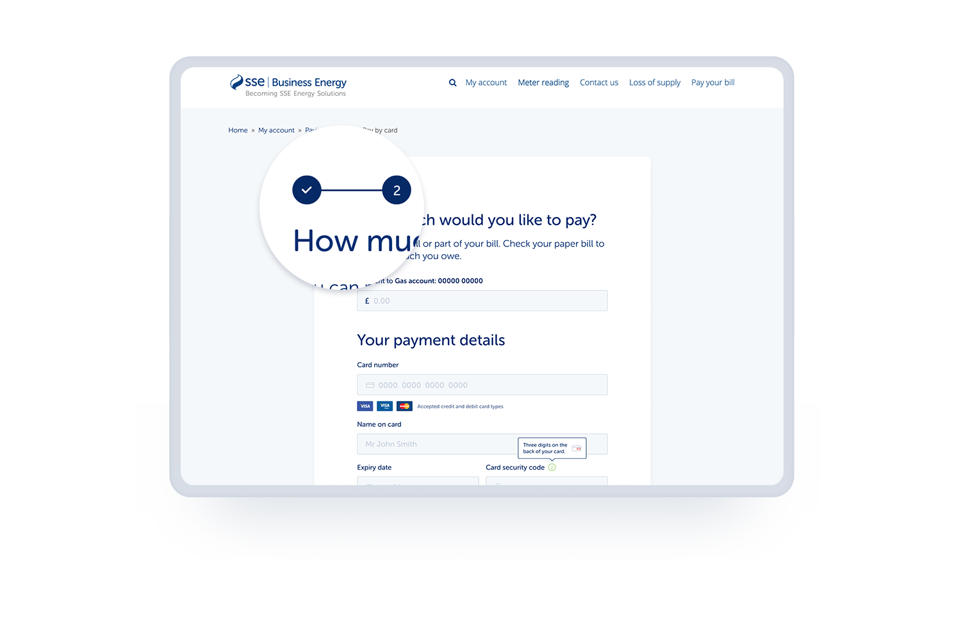
Design Approach Overview (continued)
Sketching - Sketching as a team
XD Designs - Creating high fidelity designs
CSS - Supporting Dave in building the prototype
Look and feel (continued)
Enhancement to current styles
Clean, clear and unobtrusive
Rounded corners and shadows
Large, clear headings
Typography and space

Slide 8
03
Development Approach Overview

Slide 9
Development Approach Overview
Prototyping using a high-fidelity approach using Vue.js.
Helps us think about the tools and design systems that SSE can embed (DesignOps).
Creates a more realistic and immersive experience - we get closer to natural behaviours and we learn more.
An agile approach to learn fast and cheaply.
Next iterations should include:
  Robust form validation,
  Device testing,
  Testing with people with Accessibility needs.

Slide 10
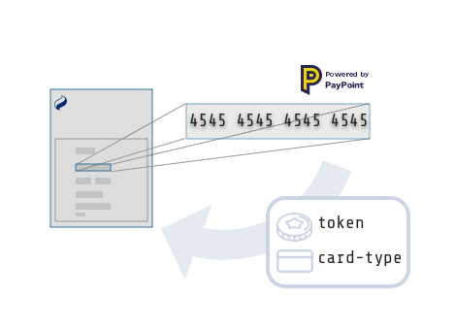
Development Approach Overview
We took a look at the PayPoint MultiPay Hosted Field solution:
We embed the hosted field script which embeds an iFrame into a placeholder in our web page
When the card number is entered, PayPoint sends us a token and the card type
https://multipay-sandbox.portal.azure-api.net/hosted_field
Next step: produce a technical proof-of-concept to validate that this works with our prototype

Slide 11
04
What We Did

Slide 12
Who We Spoke To
Participant 3
Runs an events business. Has business energy for warehouse and workshop.
Pays by Direct Debit but used to pay ad hoc at Post Office.
Participant 1
Runs a hair salon.
Pays by Direct Debit and has always paid this way.
Participant 4
Landlord for two business units.
Pays ad hoc at Post Office.
Participant 2
Runs a café / gift shop.
Pays by Direct Debit and has always paid this way.
Participant 5
Book keeps and arranges payments for restaurants and properties.
Pays by Direct Debit for most, but also does some bank transfers.

Slide 13
What We Did
We sent the participants a dummy gas and electricity bill, as well as dummy card details.
They were then asked to find where to make a payment on https://ssebusinessenergy.co.uk/
The participants were then asked to pay both the electricity and gas bill in full. This required them to enter the account numbers and amounts into the right place in the prototype, and completing the payment journey in the prototype.
​
​

Slide 14
05
What We Learned

Slide 15
Energy is a small part of running their business
Participants talked about all the other tasks they have in their day and energy only being one they do once in a while.
A café owner described being busy from 9am to 7pm so is never free to call utility companies in office hours.
Multiple participants described having more than one energy supplier. Usually down to running their business across multiple locations
So what?...
This highlights the need for the online payment system allowing people to pay at a time that is convenient.
It’s also important to remember that this task will be done infrequently and in the middle of other tasks, so users may be in rush, distracted and may not use it often enough to remember how it works.

Slide 16
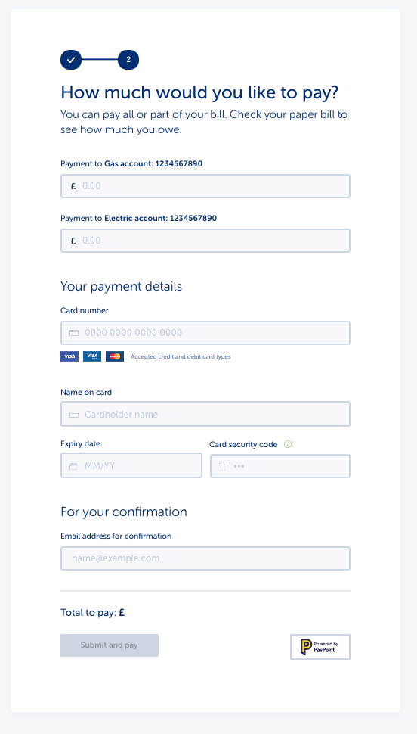
Form usability
Overall the usability of the form performed well. All participants completed the payment successfully
Participants were able to enter the credit card details correctly.
Participants were happy to provide an email address and even expected to need one for a receipt.
Nobody described the process as difficult or hard to use.
There were however some improvements that can be made…
​
​

Slide 17
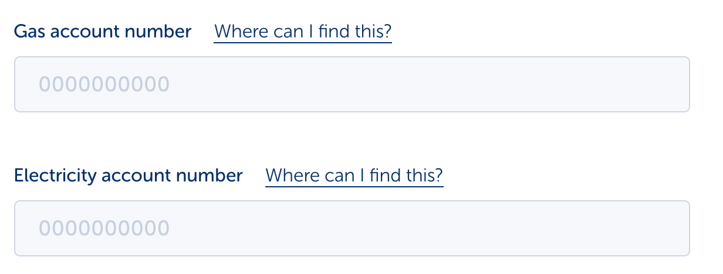
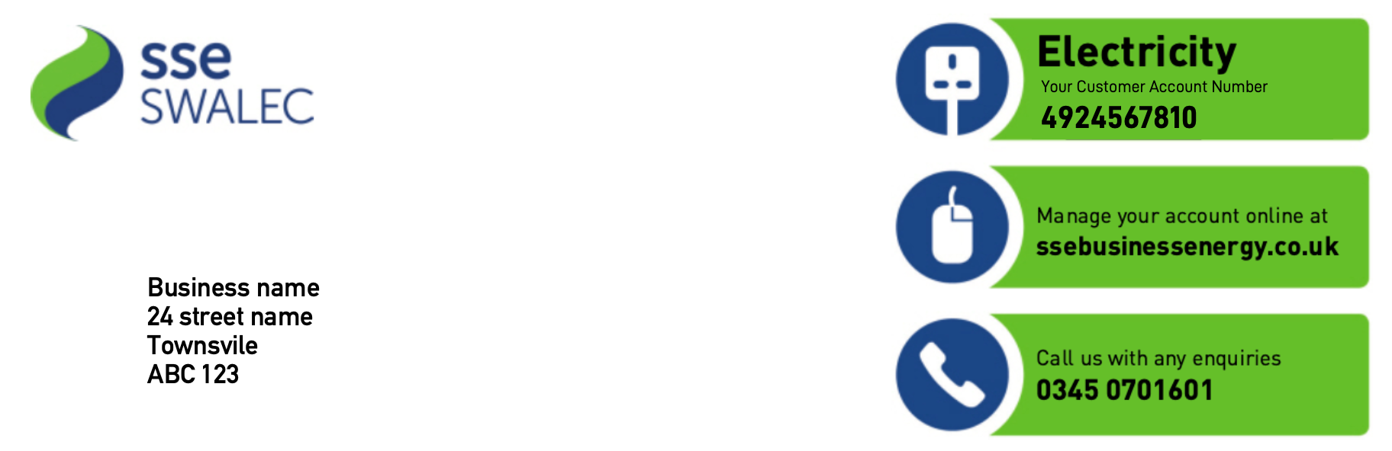
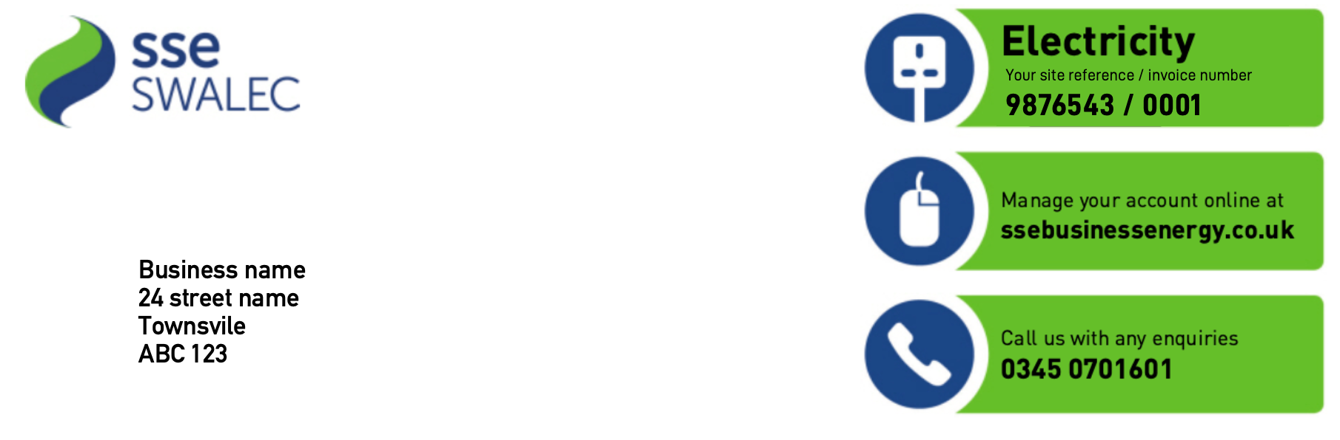
Finding the account number
None of the participants got the account number right first time. They all struggled to find it on the bill.
Some missed the link to show the instructions on where to find the account number. This left them trying to find it on the bill on their own, which took some time.
One participant inputted the site reference number as it looks very similar to the account number on the paper bill.
However, all the participants noticed their mistakes thanks to the validation based on number of digits and corrected their mistake.
Next steps:
Make the instructions on where to find the account number clearer on the form.
Consider reviewing the design of the paper bill. Make the account numbers and site references more distinct.
Paper bill page 1
Paper bill page 2

Slide 18
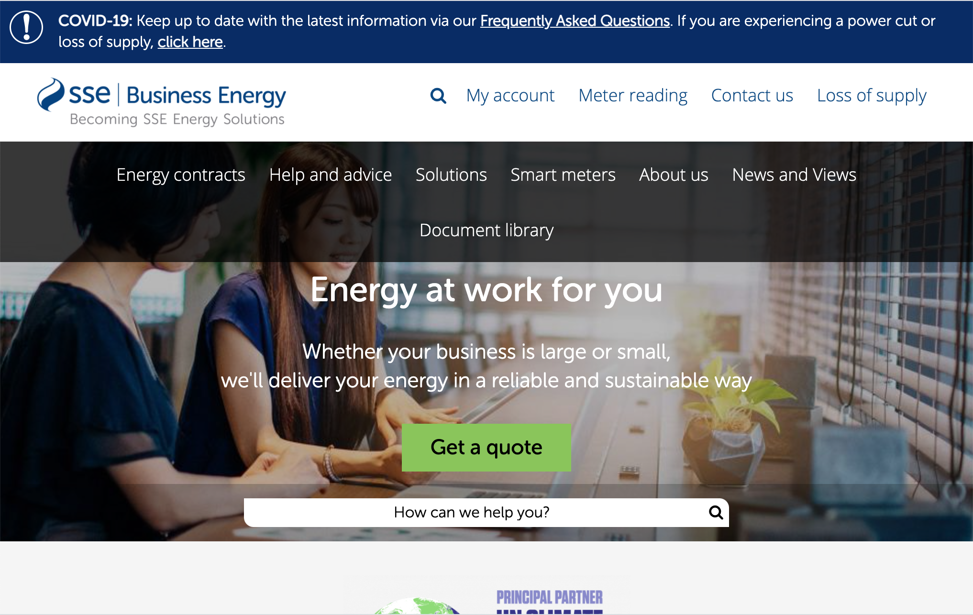

Finding the payment form
Participants assumed they would have to create an account to pay so went to the My account page to find where to pay.
Those who couldn’t find it used the search function.
However the search was confusing. When you click in the search box it says ‘How can we help you’. This looks like a link rather than a search box. Participants ended up clicking search again, which returned a set of generic search results.
​
​

Slide 19
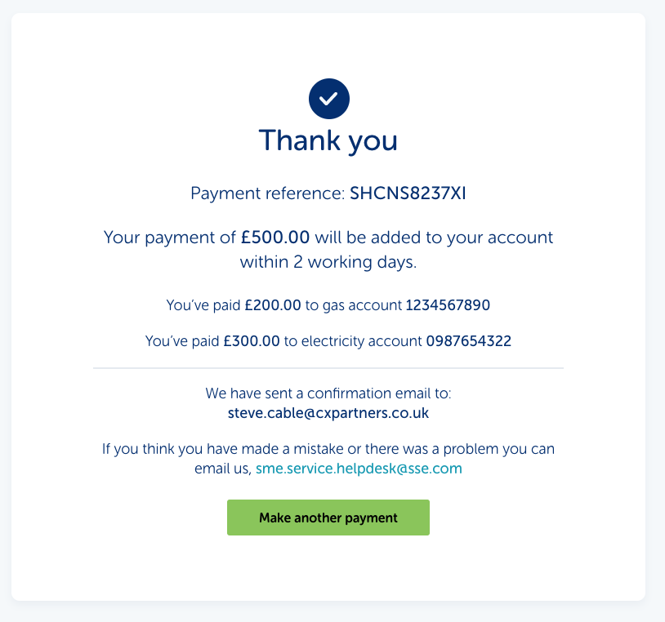
Confirmation
The confirmation page made it clear what had been done and participants felt confident the payment had gone through.
Participants all talked about wanting to send the receipt onto their accountant.
They wanted a Date as that was important for keeping record of the payment.
The account numbers weren’t spotted by one participant. This means they didn’t check if the number was correct.
Next steps
Add a date to the confirmation.
Make the account numbers more prominent.
​
​

Slide 20
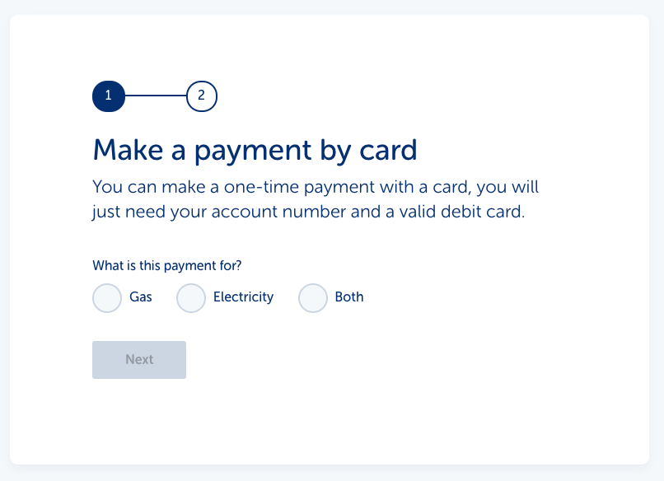
Setting expectations
When asked how confident participants were that the payment had gone to the right place, they were very confident.
They all assumed by typing in their account numbers the system had brought up their account details.
This meant the participants weren't that careful in checking they’d typed the right account number.
When we explained how the form worked and it was on them to get the account number right they had not realised this was the case.
One participant stated they would have been more careful if they’d have known.
Next step:
Make it clear up front how the form works so people are more careful. We could also use this to let people know what they will need to complete a payment (Their account number, a bill and a visa, or master card).
​
​

Slide 21
06
What’s Next

Slide 22
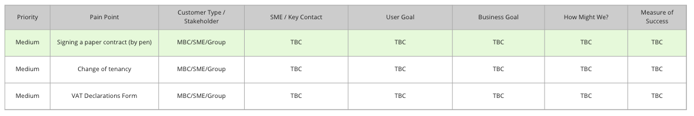
Backlog Priorities
Sprint 4 Priorities
Pain Point - Signing a paper contract (Pen)
  Focus should be on Customers rather than TPIs but the process is largely the same
  The long term goal will be allowing customers to be able to renew on line.
Backlog Snapshot

Slide 23
07
Next Steps

Slide 24
Next Steps
Sprint 4
Sprint Retro
Sprint Planning
Arrange meetings with subject matter experts (SMEs)
Begin the recruitment for user testing
  Customers – MBC, SME and Group
  TPIs
Notes:
Owned by: Ted Morris-Dawson

Slide 25
Thank You

